Slide 1
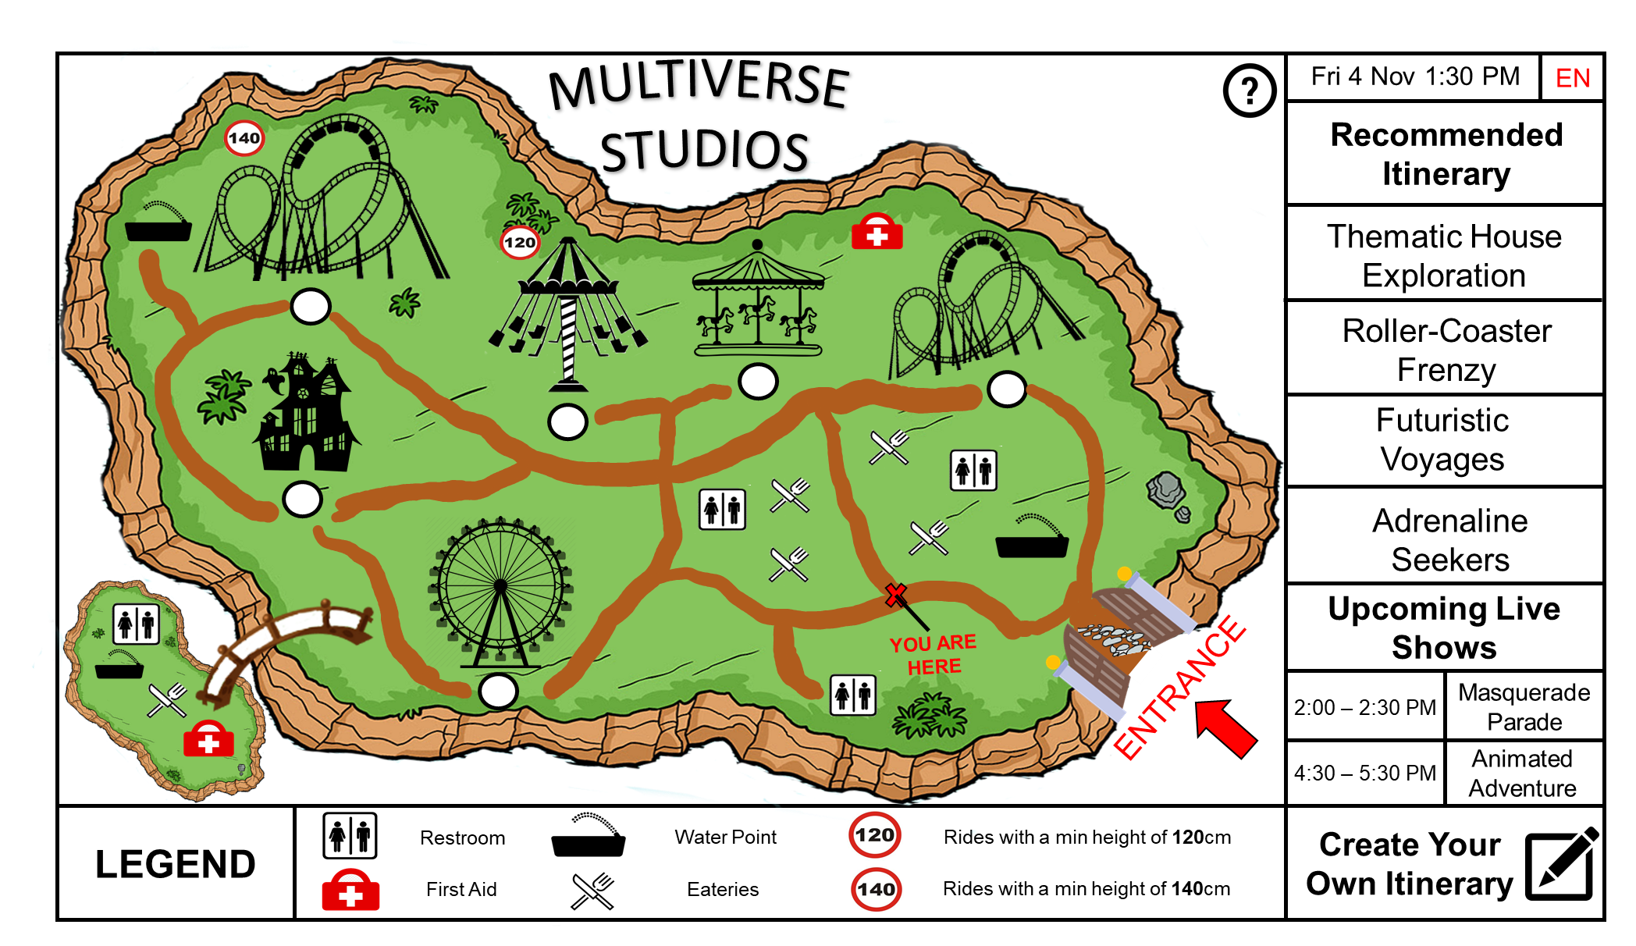
Hi-fi Prototype
Done by: Tan Yi Jie Joel(24)
Lo-fi prototype reviewed by: Liang Wei(23)
Lab group: DSAI1

Slide 2

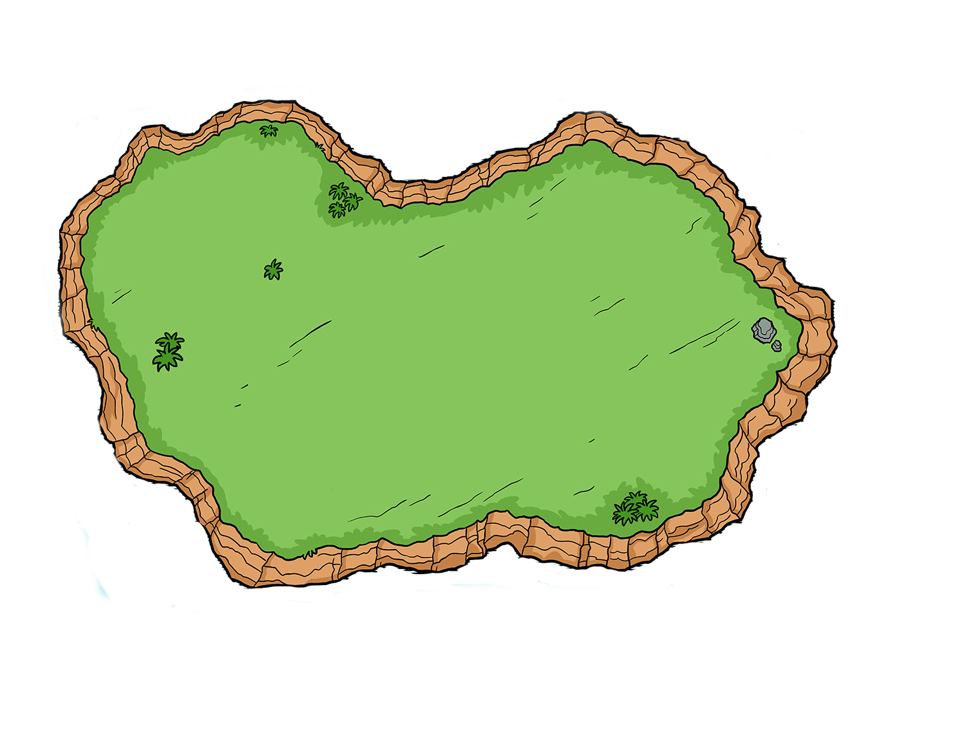







































Fri 4 Nov 1:30 PM
EN
Recommended
Itinerary
MULTIVERSE
STUDIOS
Thematic House Exploration
Roller-Coaster Frenzy
Futuristic Voyages
Adrenaline Seekers
Upcoming Live
Shows
YOU ARE HERE
ENTRANCE
Masquerade Parade
2:00 – 2:30 PM
4:30 – 5:30 PM
Animated Adventure
LEGEND
Restroom
Water Point
Rides with a min height of 120cm
Create Your Own Itinerary
First Aid
Eateries
Rides with a min height of 140cm
Notes:
Home Page – Main Interface

Slide 3

English
中文
Behasa Melayu
தமிழ்
日本語
한국
Select preferred language by clicking on it (Click on Behasa Melayu for example)
Users can click on the “x” or anywhere outside the popup box to exit
Confirm

Slide 4
Selected language is highlighted and interface will display language after confirmation
Users can click on the “x” or anywhere outside the popup box to exit
English
中文
Behasa Melayu
தமிழ்
日本語
한국
Confirm

Slide 5
Fri 4 Nov 1:30 PM
BM
Disyorkan
Jadual perjalanan
PELBAGAI
STUDIOS
Penerokaan Rumah Tematik
Click anywhere to change language back to English for rest of the demo
Kegilaan Roller-Coaster
Pelayaran Futuristik
Pencari Adrenalin
Langsung Akan
Pertunjukan
AWAK DI SINI
MASUK
Perarakan Penyamaran
2:00 – 2:30 PM
4:30 – 5:30 PM
Pengembaraan Animasi
Tunggangan dengan ketinggian minimum 120cm
Buat Jadual Perjalanan Anda Sendiri
LAGENDA
Tandas
Titik Air
Pertolongan Cemas
Kedai Makan
Tunggangan dengan ketinggian minimum 140cm
Notes:
Home Page – Main Interface

Slide 6
Fri 4 Nov 1:30 PM
EN
Recommended
Itinerary
MULTIVERSE
STUDIOS
Thematic House Exploration
Roller-Coaster Frenzy
Futuristic Voyages
Adrenaline Seekers
Upcoming Live
Shows
YOU ARE HERE
ENTRANCE
Masquerade Parade
2:00 – 2:30 PM
4:30 – 5:30 PM
Animated Adventure
LEGEND
Restroom
Water Point
Rides with a min height of 120cm
Create Your Own Itinerary
First Aid
Eateries
Rides with a min height of 140cm
Notes:
Home Page – Main Interface

Slide 7
Clicking on the buttons below the rides will show details regarding that ride

Slide 8
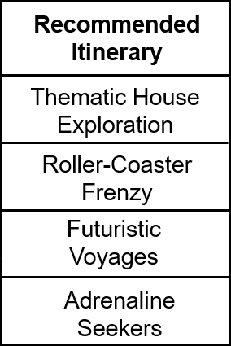
Click on a range of curated itineraries for a guide on how to enjoy our theme park

Slide 9

Click here to see the entire list of live show timings for the day

Slide 10

Click here to create your own personal itinerary

Slide 11

Live Show Timings
1:00 – 1:30 PM Amusement Show 1
2:00 – 2:30 PM Masquerade Parade
4:30 – 5:30 PM Animated Adventure
7:30 – 8:30 PM Amusement Show 2
9:00 – 9:30 PM Light Show with Fireworks
Previous show timings are greyed out
Entire day of live show timings are displayed
Users can click on the “x” to exit or anywhere outside the popup box

Slide 12
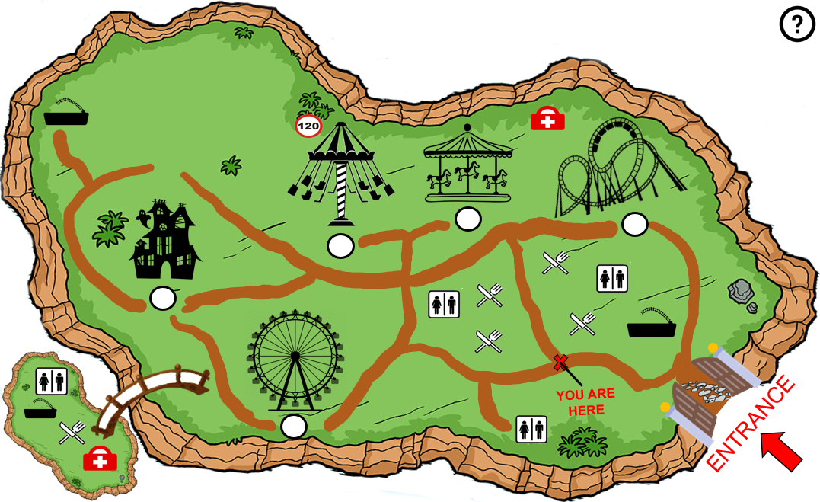
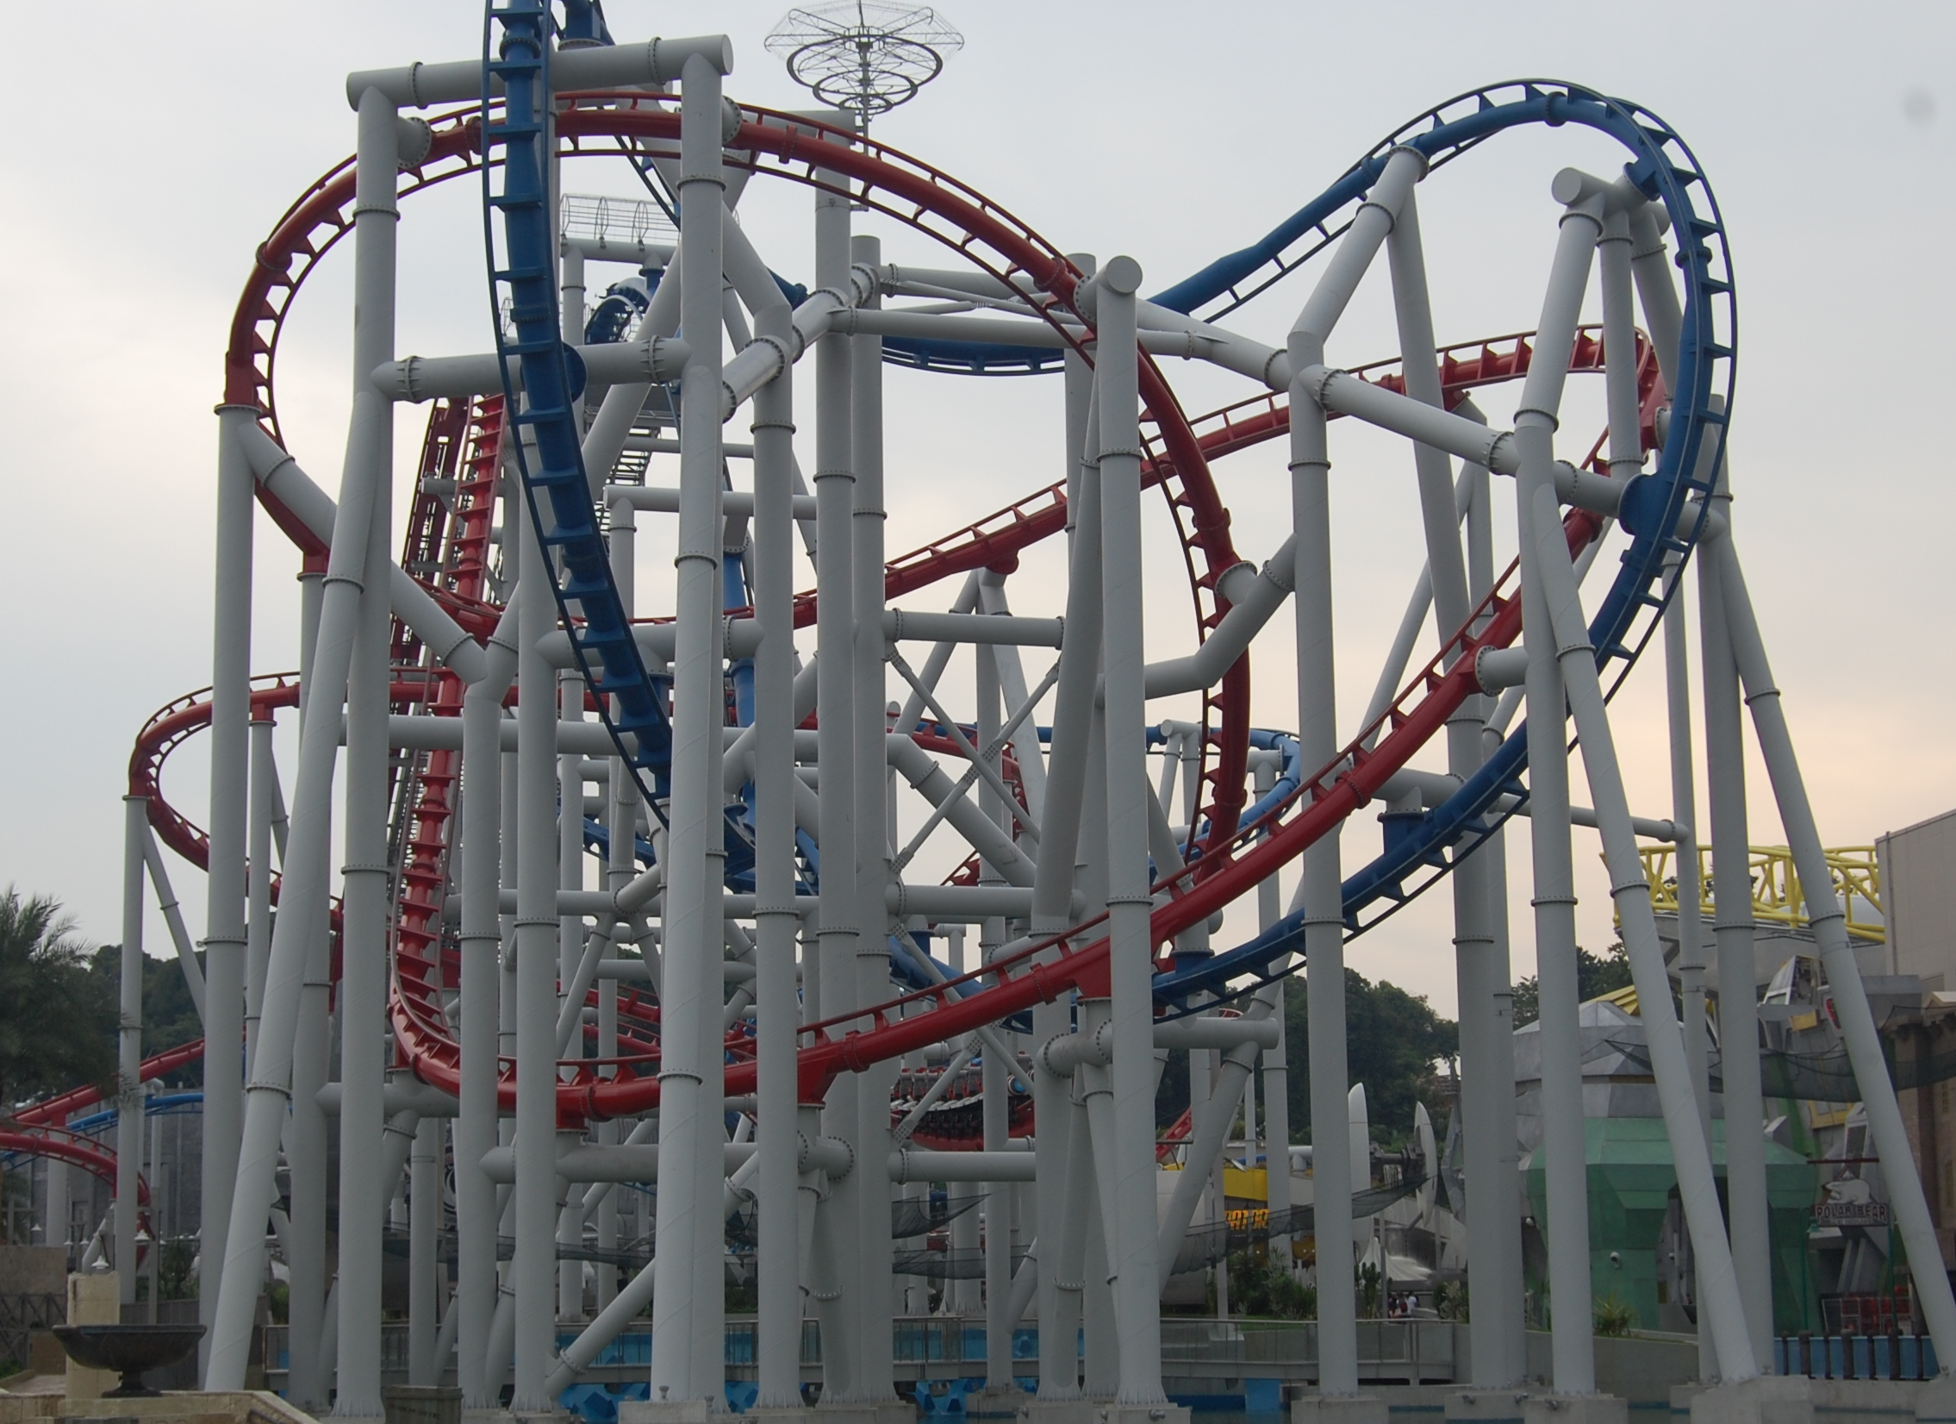
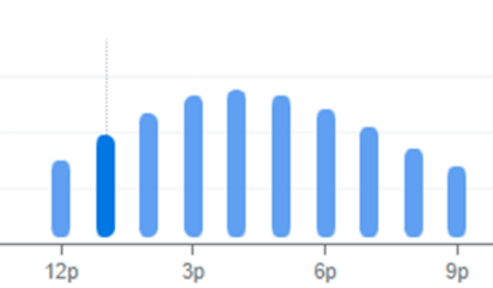
Fri 4 Nov 1:30 PM
EN
Recommended
Itinerary
MULTIVERSE
STUDIOS
Battleship Galactic
Estimated Wait Time : 35 ~ 45min
Popular Times :
Travel Time : 5mins
Description : A high adrenaline action twisting ride
Min Height : 140cm
Thematic House Exploration
Roller-Coaster Frenzy
Futuristic Voyages
Attraction details popup
Users can click on “directions to get there” to show path leading to attraction from current location
Adrenaline Seekers
Upcoming Live
Shows
2:00 – 2:30 PM
Masquerade Parade
Directions to get there
4:30 – 5:30 PM
Animated Adventure
LEGEND
Restroom
Water Point
Rides with a min height of 120cm
Create Your Own Itinerary
First Aid
Eateries
Rides with a min height of 140cm
Notes:
Home Page – Main Interface

Slide 13
Fri 4 Nov 1:30 PM
EN
Recommended
Itinerary
MULTIVERSE
STUDIOS
Thematic House Exploration
Roller-Coaster Frenzy
Futuristic Voyages
Watch path animation
Adrenaline Seekers
Upcoming Live
Shows
YOU ARE HERE
ENTRANCE
Masquerade Parade
2:00 – 2:30 PM
4:30 – 5:30 PM
Animated Adventure
LEGEND
Restroom
Water Point
Rides with a min height of 120cm
Create Your Own Itinerary
First Aid
Eateries
Rides with a min height of 140cm
Notes:
Home Page – Main Interface

Slide 14






Fri 4 Nov 1:30 PM
EN
Path is generated for users automatically when they select the recommended itinerary
(Watch animation)
Roller-Coaster Frenzy
MULTIVERSE
STUDIOS
Half-day
Full-day
Tornado
2
Battleship
Galactic
1
5
The Flyer
Lunch
4
Thunder Ride
YOU ARE HERE
ENTRANCE
ADD NEW ATTRACTION
3
Upcoming Live Shows
2:00 – 2:30 PM
Masquerade Parade
LEGEND
Restroom
Water Point
Rides with a min height of 120cm
NEXT
UNDO
First Aid
Eateries
Rides with a min height of 140cm
Notes:
Home Page – Main Interface

Slide 15

Fri 4 Nov 1:30 PM
EN
Path will automatically change when user changes order of items to do in itinerary
(Watch Animation)
E.g. Swapping “Thunder Ride” with “Lunch”
Roller-Coaster Frenzy
MULTIVERSE
STUDIOS
Half-day
Full-day
Tornado
2
Battleship
Galactic
1
4
5
The Flyer
Lunch
3
5
4
Thunder Ride
YOU ARE HERE
ENTRANCE
ADD NEW ATTRACTION
Upcoming Live Shows
2:00 – 2:30 PM
Masquerade Parade
LEGEND
Restroom
Water Point
Rides with a min height of 120cm
NEXT
UNDO
First Aid
Eateries
Rides with a min height of 140cm
Notes:
Itinerary swapping

Slide 16
Fri 4 Nov 1:30 PM
EN
Path will automatically change when item in itinerary is removed by clicking on “x” icon
E.g. Removing “Lunch”
Roller-Coaster Frenzy
MULTIVERSE
STUDIOS
Half-day
Full-day
Tornado
2
Battleship
Galactic
1
4
The Flyer
Thunder Ride
3
5
Lunch
YOU ARE HERE
ENTRANCE
ADD NEW ATTRACTION
Upcoming Live Shows
2:00 – 2:30 PM
Masquerade Parade
LEGEND
Restroom
Water Point
Rides with a min height of 120cm
NEXT
UNDO
First Aid
Eateries
Rides with a min height of 140cm
Notes:
Itinerary swapping

Slide 17
Fri 4 Nov 1:30 PM
EN
Roller-Coaster Frenzy
Removal of path to “lunch” and “lunch” item disappear
(Watch Animation)
MULTIVERSE
STUDIOS
Half-day
Full-day
Tornado
2
Battleship
Galactic
1
4
The Flyer
Thunder Ride
3
5
Lunch
YOU ARE HERE
ENTRANCE
ADD NEW ATTRACTION
Upcoming Live Shows
2:00 – 2:30 PM
Masquerade Parade
LEGEND
Restroom
Water Point
Rides with a min height of 120cm
NEXT
UNDO
First Aid
Eateries
Rides with a min height of 140cm
Notes:
Itinerary swapping

Slide 18
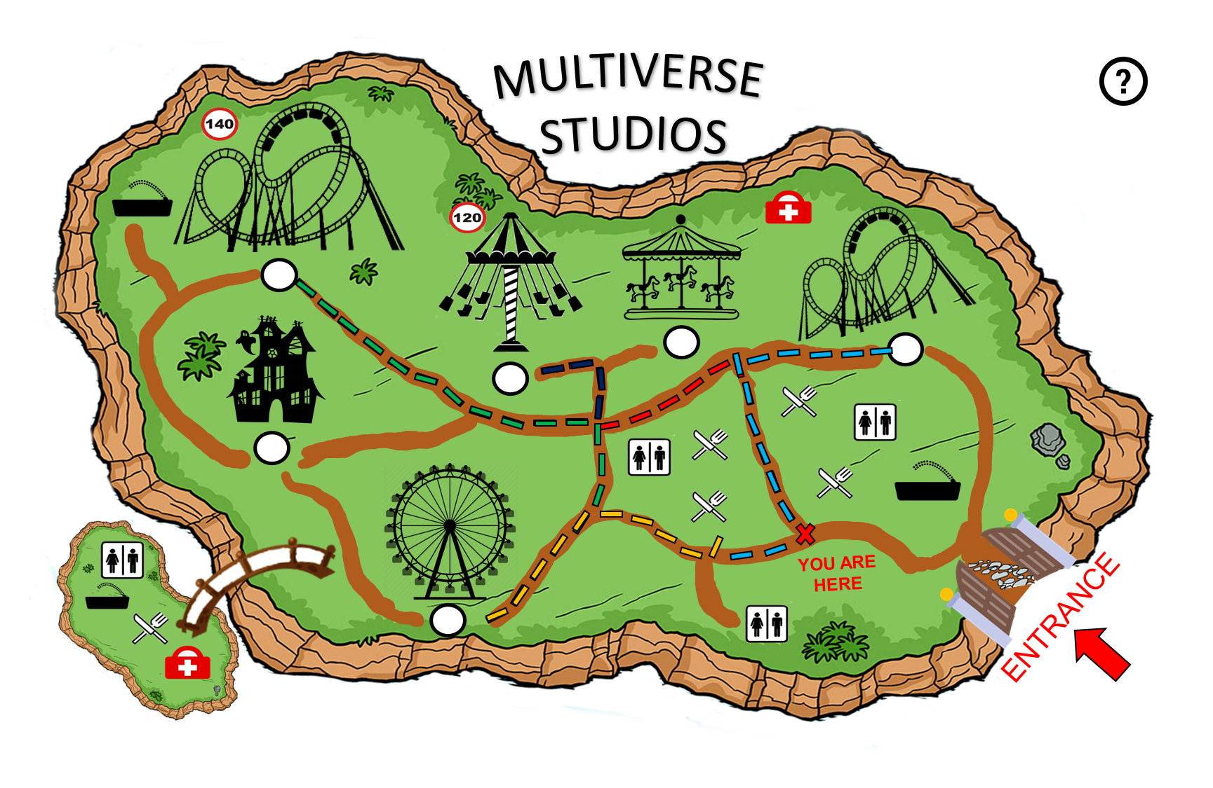

Fri 4 Nov 1:30 PM
EN
Custom Itinerary 1
Rides
House of Horror
Victory Spin
Live Shows
2:00 – 2:30 PM Masquerade Parade
4:30 – 5:30 PM Animated Adventure
7:30 – 8:30 PM Amusement Show 2
9:00 – 9:30 PM Light Show
Half-day
Full-day
Click to add “Victory Spin” and “Light Show” to custom itinerary
Tornado
Battleship
Galactic
The Flyer
Thunder Ride
Lunch
Victory Spin
Light Show (9.00pm)
ADD NEW ATTRACTION
Upcoming Live Shows
2:00 – 2:30 PM
Masquerade Parade
LEGEND
Restroom
Water Point
Rides with a min height of 120cm
NEXT
UNDO
First Aid
Eateries
Rides with a min height of 140cm
Notes:
Home Page – Main Interface

Slide 19
(Watch Animation)
Path to “Victory Spin” and “Light Show” automatically added in order
Click on slide for user to rename itinerary
Click on Next to proceed and save
Fri 4 Nov 1:30 PM
EN
Custom Itinerary 1
My Ideal Itinerary
MULTIVERSE
STUDIOS
Half-day
Full-day
7
Tornado
2
Battleship
Galactic
1
6
4
The Flyer
Thunder Ride
5
Lunch
3
Victory Spin
Light Show (9.00pm)
YOU ARE HERE
ENTRANCE
ADD NEW ATTRACTION
Upcoming Live Shows
2:00 – 2:30 PM
Masquerade Parade
LEGEND
Restroom
Water Point
Rides with a min height of 120cm
NEXT
UNDO
First Aid
Eateries
Rides with a min height of 140cm
Notes:
Itinerary swapping

Slide 20
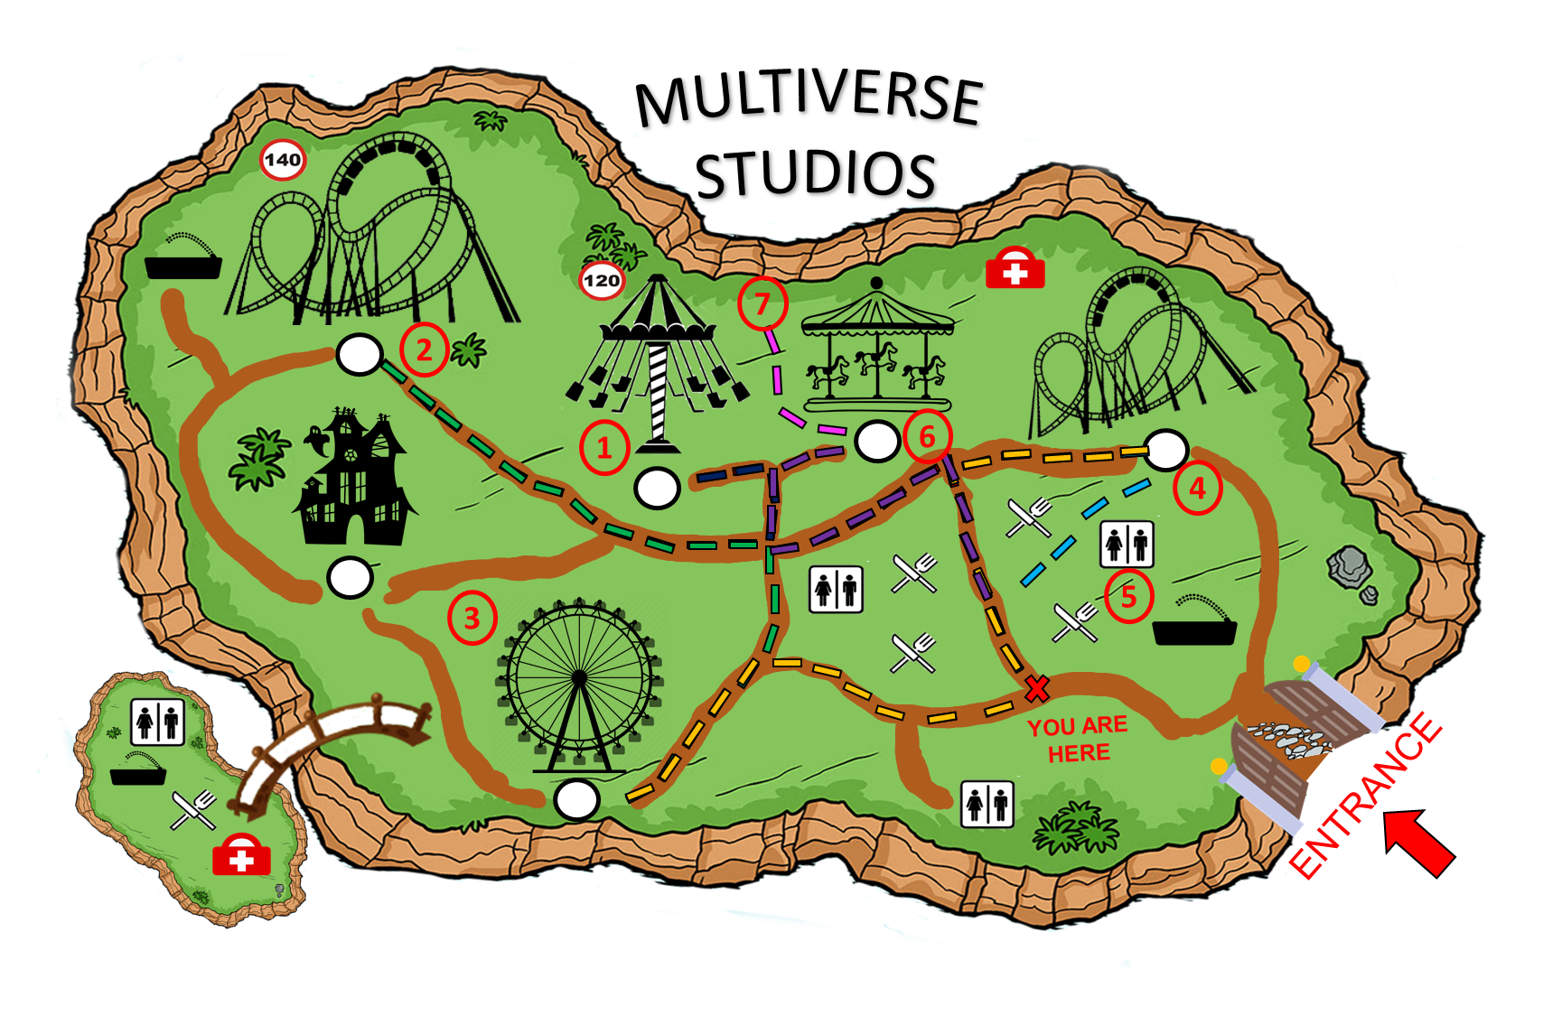

Fri 4 Nov 1:30 PM
EN
My Ideal Itinerary
Click on “Green Tick or Next” to save
Click on “Red X” to go back
Half-day
Full-day
Tornado
Battleship
Galactic
Save this itinerary?
The Flyer
Thunder Ride
Lunch
Victory Spin
Light Show (9.00pm)
ADD NEW ATTRACTION
Upcoming Live Shows
2:00 – 2:30 PM
Masquerade Parade
LEGEND
Restroom
Water Point
Rides with a min height of 120cm
NEXT
UNDO
First Aid
Eateries
Rides with a min height of 140cm
Notes:
Itinerary swapping

Slide 21

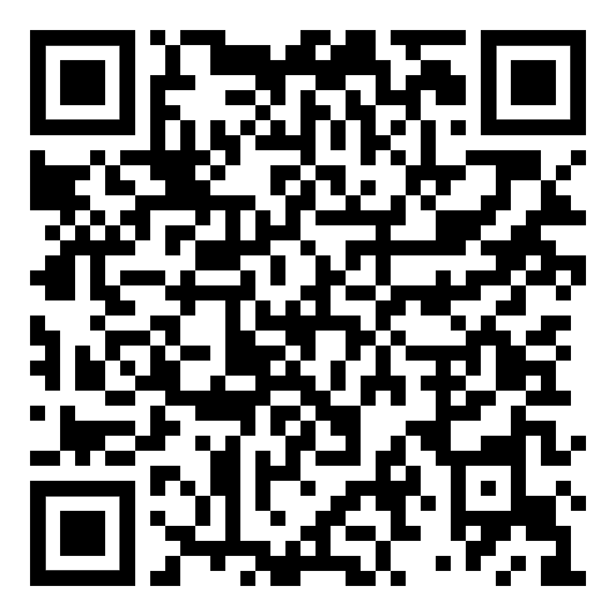
Fri 4 Nov 1:30 PM
EN
My Ideal Itinerary
Tap your phone here to download your itinerary
Or scan this QR code
Click on icon or “QR code” to simulate download
Half-day
Full-day
Tornado
Battleship
Galactic
The Flyer
Thunder Ride
Lunch
Victory Spin
Light Show (9.00pm)
ADD NEW ATTRACTION
Upcoming Live Shows
2:00 – 2:30 PM
Masquerade Parade
LEGEND
Restroom
Water Point
Rides with a min height of 120cm
NEXT
UNDO
First Aid
Eateries
Rides with a min height of 140cm
Notes:
Itinerary swapping

Slide 22

Fri 4 Nov 1:30 PM
Fri 4 Nov 1:30 PM
Fri 4 Nov 1:30 PM
EN
EN
EN
My Ideal Itinerary
My Ideal Itinerary
My Ideal Itinerary
MULTIVERSE
STUDIOS
MULTIVERSE
STUDIOS
Pop-up to let users know download/save complete
Download and save successful
Half-day
Half-day
Half-day
Full-day
Full-day
Full-day
7
7
Tornado
Tornado
Tornado
2
2
Battleship
Galactic
Battleship
Galactic
Battleship
Galactic
6
1
Loading…
6
1
The Flyer
The Flyer
4
The Flyer
4
Thunder Ride
Thunder Ride
Thunder Ride
Lunch
Lunch
5
Lunch
Returning to show map with itinerary …
5
3
3
Victory Spin
Victory Spin
Victory Spin
Light Show (9.00pm)
Light Show (9.00pm)
Light Show (9.00pm)
YOU ARE HERE
YOU ARE HERE
ADD NEW ATTRACTION
ADD NEW ATTRACTION
ENTRANCE
ADD NEW ATTRACTION
ENTRANCE
Upcoming Live Shows
Upcoming Live Shows
Upcoming Live Shows
Masquerade Parade
Masquerade Parade
2:00 – 2:30 PM
Masquerade Parade
2:00 – 2:30 PM
2:00 – 2:30 PM
Water Point
Create A New Itinerary
Water Point
Water Point
Rides with a min height of 120cm
Rides with a min height of 120cm
Restroom
Rides with a min height of 120cm
Restroom
LEGEND
Restroom
LEGEND
LEGEND
Rides with a min height of 140cm
Rides with a min height of 140cm
Eateries
Rides with a min height of 140cm
Eateries
First Aid
Eateries
First Aid
First Aid
Notes:
Itinerary swapping

Slide 23
Fri 4 Nov 1:30 PM
EN
Recommended
Itinerary
MULTIVERSE
STUDIOS
Thematic House Exploration
Roller-Coaster Frenzy
Futuristic Voyages
Adrenaline Seekers
Upcoming Live
Shows
YOU ARE HERE
ENTRANCE
Masquerade Parade
2:00 – 2:30 PM
4:30 – 5:30 PM
Animated Adventure
LEGEND
Restroom
Water Point
Rides with a min height of 120cm
Create Your Own Itinerary
First Aid
Eateries
Rides with a min height of 140cm
Notes:
Home Page – Main Interface

Slide 24
Scenario : Family of 4 with children under 120cm are using the machine
We noticed that you came as a family of 4, would you like to create a shared itinerary or independent itineraries?
Common
Independent
A common itinerary would be similar to the recommended one.
Click on the Independent itinerary for the simultaneous creation of multiple itineraries

Slide 25
We noticed that there are children under the height limit of some of our rides. Restricted rides will be greyed out.
E.g. Battleship Galactic

Slide 26
Sample rides have been added to the itineraries 2,3,4.
Click on “Add new attraction” for itinerary 1 to go through process
Fri 4 Nov 1:30 PM
EN
Itinerary 1
~ Empty ~
MULTIVERSE
STUDIOS
ADD NEW ATTRACTION
Itinerary 2
Haunted House
1
ADD NEW ATTRACTION
1
2
Itinerary 3
Tornado
Victory Spin
1
ADD NEW ATTRACTION
Itinerary 4
YOU ARE HERE
Thunder Ride
ENTRANCE
ADD NEW ATTRACTION
Upcoming Live Shows
2:00 – 2:30 PM
Masquerade Parade
LEGEND
Restroom
Water Point
Rides with a min height of 120cm
NEXT
UNDO
First Aid
Eateries
Rides with a min height of 140cm
Notes:
Home Page – Main Interface

Slide 27
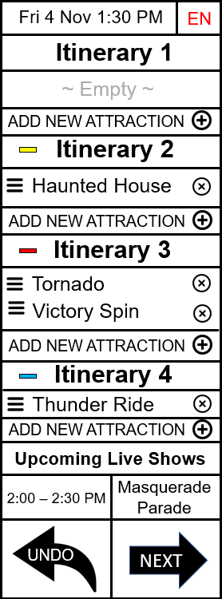
Fri 4 Nov 1:30 PM
EN
Custom Itinerary 1
Battleship Galactic greyed out due to member of group under 140cm
… represents other rides that can be added
Scenario -> add “The Flyer” into itinerary 1
Rides
Battleship Galactic
The Flyer
…
Live Shows
2:00 – 2:30 PM Masquerade Parade
4:30 – 5:30 PM Animated Adventure
7:30 – 8:30 PM Amusement Show 2
9:00 – 9:30 PM Light Show
Half-day
Full-day
Tornado
Battleship
Galactic
The Flyer
Thunder Ride
Lunch
Victory Spin
Light Show (9.00pm)
ADD NEW ATTRACTION
Upcoming Live Shows
2:00 – 2:30 PM
Masquerade Parade
LEGEND
Restroom
Water Point
Rides with a min height of 120cm
NEXT
UNDO
First Aid
Eateries
Rides with a min height of 140cm
Notes:
Home Page – Main Interface

Slide 28
Fri 4 Nov 1:30 PM
EN
Itinerary 1
Click on “NEXT” to save and proceed
(Path animation will play)
MULTIVERSE
STUDIOS
The Flyer
ADD NEW ATTRACTION
Itinerary 2
Haunted House
1
ADD NEW ATTRACTION
1
2
Itinerary 3
Tornado
Victory Spin
1
ADD NEW ATTRACTION
Itinerary 4
YOU ARE HERE
Thunder Ride
1
ENTRANCE
ADD NEW ATTRACTION
Upcoming Live Shows
2:00 – 2:30 PM
Masquerade Parade
LEGEND
Restroom
Water Point
Rides with a min height of 120cm
NEXT
UNDO
First Aid
Eateries
Rides with a min height of 140cm
Notes:
Home Page – Main Interface

Slide 29
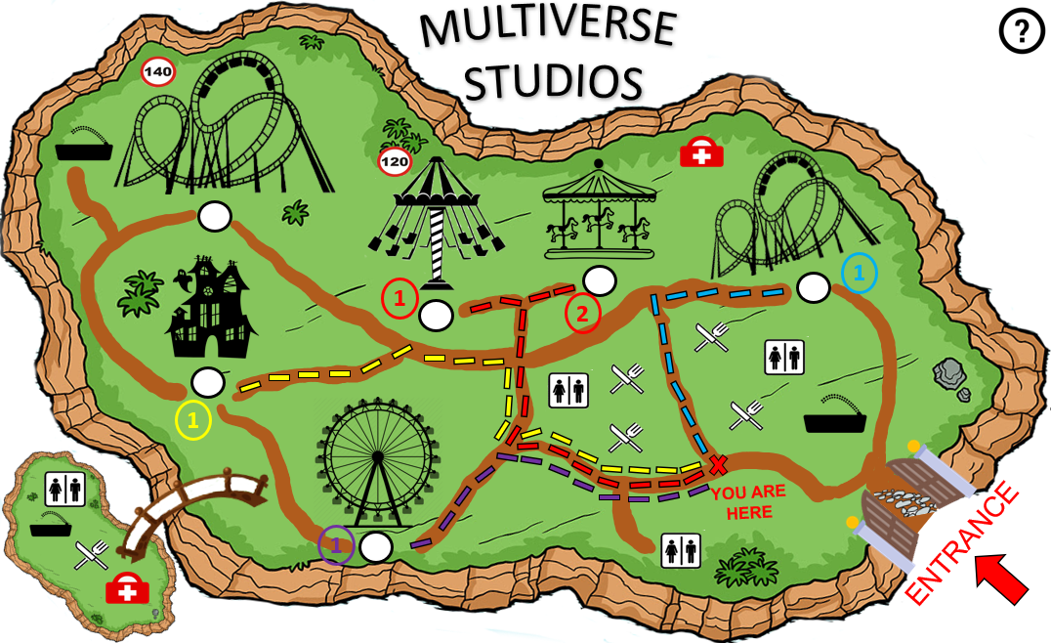
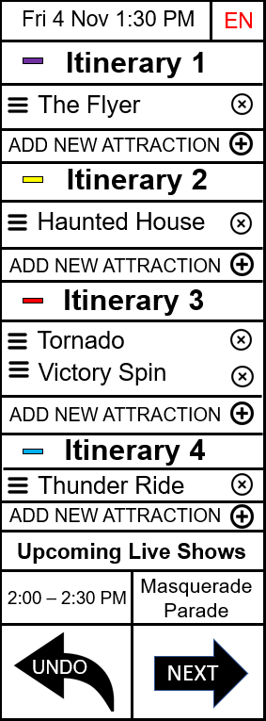
Fri 4 Nov 1:30 PM
EN
My Ideal Itinerary
Click on “Green Tick or Next” to save
Click on “Red X” to go back
Half-day
Full-day
Tornado
Battleship
Galactic
Save this itinerary?
The Flyer
Thunder Ride
Lunch
Victory Spin
Light Show (9.00pm)
ADD NEW ATTRACTION
Upcoming Live Shows
2:00 – 2:30 PM
Masquerade Parade
LEGEND
Restroom
Water Point
Rides with a min height of 120cm
NEXT
UNDO
First Aid
Eateries
Rides with a min height of 140cm
Notes:
Itinerary swapping

Slide 30
Click on individual or QR Code to see animation
Fri 4 Nov 1:30 PM
EN
My Ideal Itinerary
Tap your phone at or scan QR code to save itinerary
Half-day
Full-day
Tornado
Itinerary 1
Itinerary 2
Itinerary 3
Itinerary 4
Battleship
Galactic
Download and save successful
Download and save successful
Download and save successful
Download and save successful
Download and save successful
Download and save successful
Download and save successful
Download and save successful
The Flyer
Thunder Ride
Loading…
Loading…
Loading…
Lunch
Loading…
Loading…
Loading…
Loading…
Loading…
Victory Spin
Light Show (9.00pm)
Waiting for other downloads…
Waiting for other downloads…
Waiting for other downloads…
Waiting for other downloads…
Waiting for other downloads…
Waiting for other downloads…
Waiting for other downloads…
Waiting for other downloads…
ADD NEW ATTRACTION
Upcoming Live Shows
2:00 – 2:30 PM
Masquerade Parade
LEGEND
Restroom
Water Point
Rides with a min height of 120cm
NEXT
UNDO
First Aid
Eateries
Rides with a min height of 140cm
Notes:
Itinerary swapping

Slide 31

Fri 4 Nov 1:30 PM
EN
My Ideal Itinerary
All Downloads Completed!
Returning to Main Page…
Half-day
Full-day
Tornado
Battleship
Galactic
The Flyer
Thunder Ride
Lunch
Victory Spin
Light Show (9.00pm)
ADD NEW ATTRACTION
Upcoming Live Shows
2:00 – 2:30 PM
Masquerade Parade
LEGEND
Restroom
Water Point
Rides with a min height of 120cm
NEXT
UNDO
First Aid
Eateries
Rides with a min height of 140cm
Notes:
Itinerary swapping

Slide 32
Thank you for your time!
Done by: Tan Yi Jie Joel(24)
(Press esc to end or click again to go back to the main page)

Slide 33
Fri 4 Nov 1:30 PM
EN
My Ideal Itinerary
Tap your phone at or scan QR code to save itinerary
Half-day
Full-day
Tornado
Itinerary 1
Itinerary 2
Itinerary 3
Itinerary 4
Battleship
Galactic
The Flyer
Thunder Ride
Lunch
Victory Spin
Light Show (9.00pm)
ADD NEW ATTRACTION
Upcoming Live Shows
2:00 – 2:30 PM
Masquerade Parade
LEGEND
Restroom
Water Point
Rides with a min height of 120cm
NEXT
UNDO
First Aid
Eateries
Rides with a min height of 140cm
Notes:
Itinerary swapping

